Slide 1

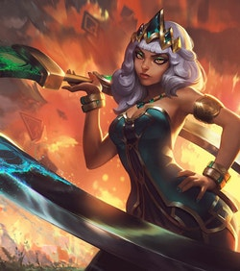

Project #1
Lauren
Jim
Dylan
Raj
Angie

Slide 2
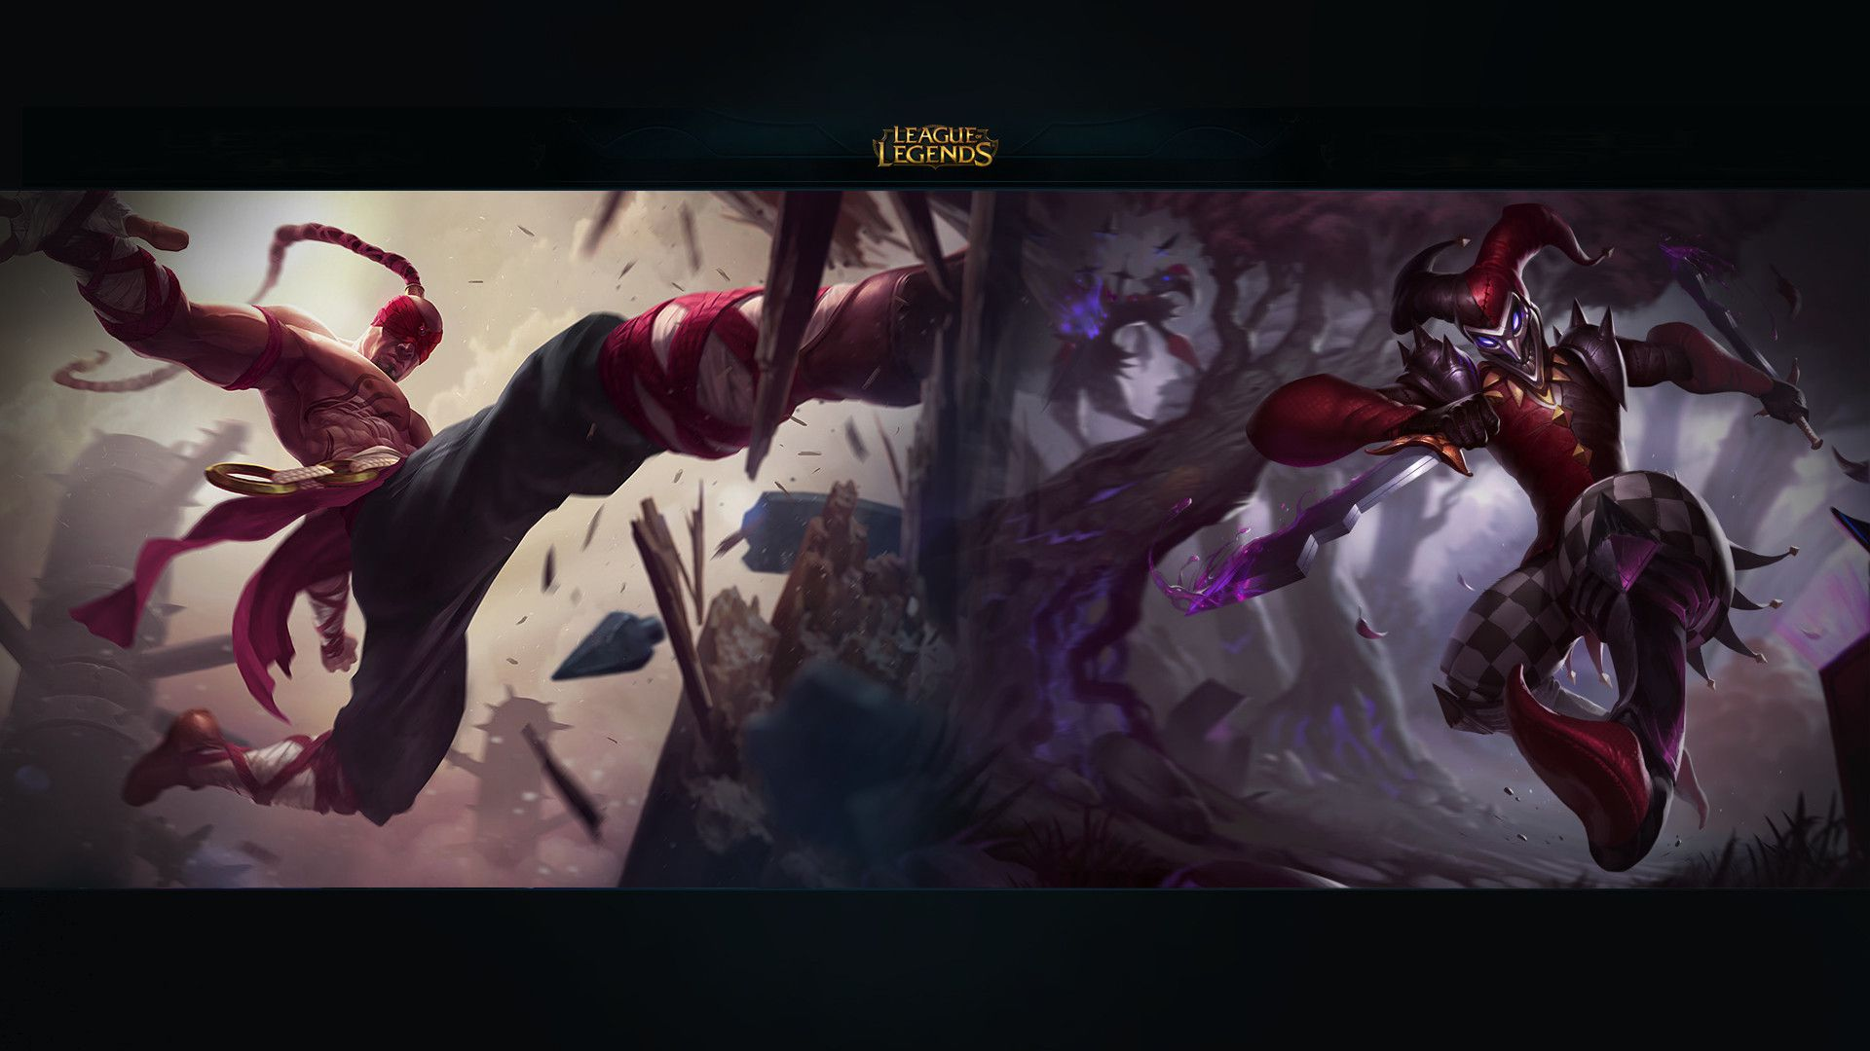
Team-based strategy game
Blue Team
Red Team
Five Champions
Five Champions
Minions
Towers
Champions
Over 140 champions
Five core abilities, two spells and seven items
Notes:
Purpose of the slide: Brief overview of the game

Slide 3






Champion Roles
FARM. KITE. CARRY
SMITE. GANK. TAX
THE WORLD IS A DESERT. I AM THE OASIS
SUPPORT
SOLO
AD CARRY
JUNGLE
MID
PROTECT. HARASS. DOMINATE
PUSH. CARRY. ROAM
Notes:
Introduce character roles and explain a bit about them

Slide 4
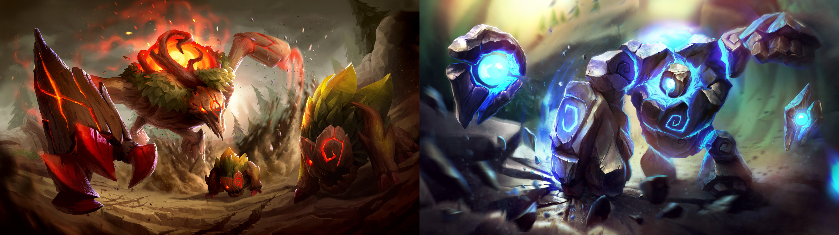





CREATE A SUPER SQUAD
Analysis Workflow
Step 1
STEP 2
STEP 3
STEP 4
STEP 5
Data Source
Explore the data across leagues
whatever
Almost done
end
Notes:
Slide contents:
Introduce the objective of our project
Outline of analysis

Slide 5

Notes:
Purpose of the slide: Brief overview of the game

Slide 6
Notes:
Purpose of the slide: Brief overview of the game

